Slide 1
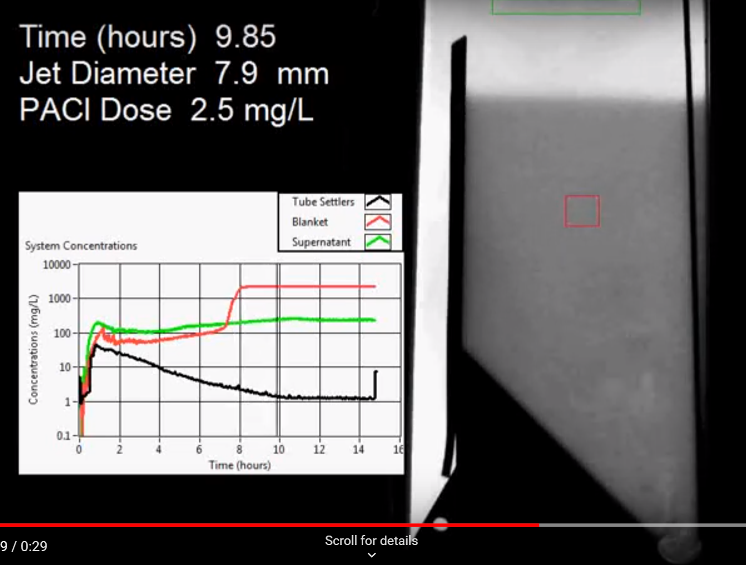
Turbidity stops decreasing before primary filter stops growing!
Notes:
How does the primary filter remove small particles?
Are plate settlers needed after a primary filter?
What determines how fast the floc/water interface rises? 100mg/L*1mm/s = 3000 mg/L * x mm/s
Why might a primary filter reduce settled water turbidity?
How is water entering the tank?
Where do the solids eventually go?
What mechanisms could result in particle aggregation in a primary filter?
It’s a filter
It’s a flocculator
Wait, filters and flocculators are really quite similar. (particles colliding and attaching)
New question: which flocs are active and which flocs are inactive in the primary filter?

Slide 2
Primary filter observations
First order removal with respect to depth initially
Turbidity above the primary filter is similar to raw water turbidity (Dr. Casey Garland observation)
Primary particle capture may continue at primary filter depths greater than 1 m

Slide 3
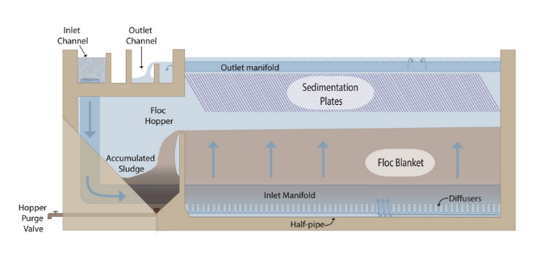
Primary filters reduce settled water turbidity
Research required to determine optimal upflow velocity
Primary filter formation requires
All flocs be returned to the bottom of the AguaClarifier (plate settlers)
All settled flocs must be resuspended by incoming water (jet reverser)
Primary filters need flocculators AND plate settlers!

Slide 4
Vertical Flow Sedimentation Tanks
Have lower velocities and hence turbulence levels might be lower (plan view area is larger than width x height
Require careful attention to delivery and extraction of water
AguaClara uses channels at one end of the tanks that are connected to pipes to deliver and extract water – other geometries would be possible

Slide 5
Stagnant Water (or Ripe for Innovation?)
extra
State of the art in sedimentation…
Empirical guidelines
Little understanding of effects of temperature or of core particle properties
Last significant paper on tube settlers was published in 1978
No significant revisions to Ten State Standards section on sedimentation in the past 30 years
Notes:
Personal communication with Daryl Bond and Frank Kulick of Brentwood Industries
9 records in Compendex for 1884-2010 Save Search - Create Alert -
((((tube settler) WN ALL)) AND ({water treatment} WN CV))
TUBULAR SETTLERS - A TECHNICAL REVIEW. Willis, Roderick M. Source: Journal / American Water Works Association, v 70, n 6, p 331-335, Jun 1978

Slide 6
Time to switch strategies
Shear is what we used to create collisions between particles and significantly reduce the concentration of primary particles
Shear PREVENTS particles of different sizes from colliding
We’d like to get collisions between big flocs and primary particles (We need relative motion and we can’t use shear!)
How else can we get relative motion?

Slide 7

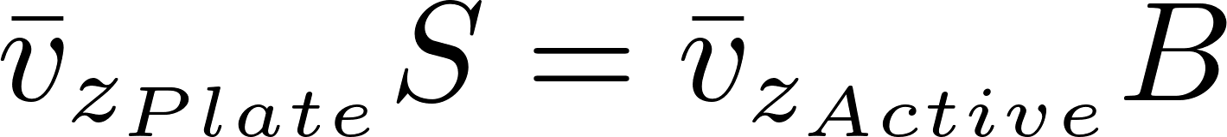
AguaClarifier Velocities
Notes:
Give the two reasons why water accelerates when it enters the plate settlers.
It has less cross sectional area due to the space occupied by the plate settler material
It must maintained the same vertical flow velocity and it must also add a horizontal component due to the slope of the plates.

Slide 8
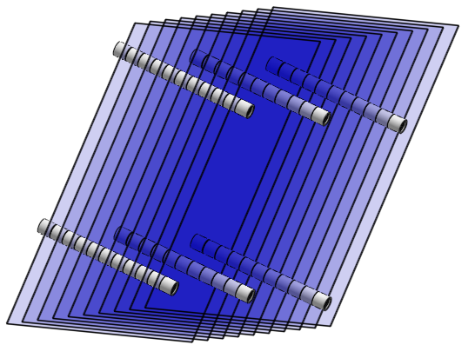
Plate Settler Redesign: Ideal plate settlers
Short retention time to reduce temperature density current effect (and reduce costs)
Ideally concentrate solids to points
4 strategies to prevent floc roll up
Upflow with large plate spacing (conventional solution)
Upflow with W plates that concentrate solids to density currents
Fluid flow down (particles must be sucked out- venture in inlet diffusers)
Fluid flow sideways
Notes:
Perhaps it is time to redesign plate settlers!

Slide 9

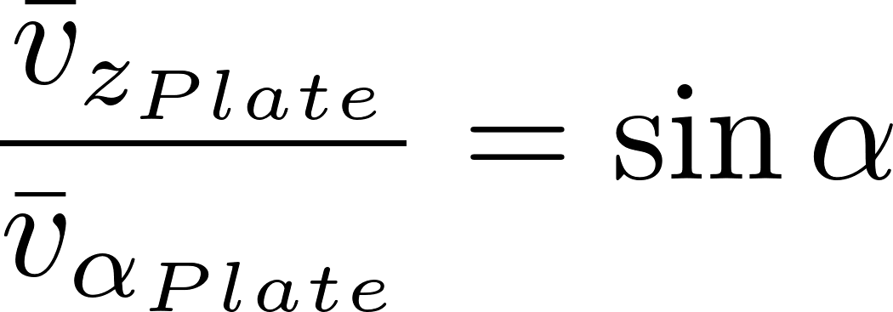
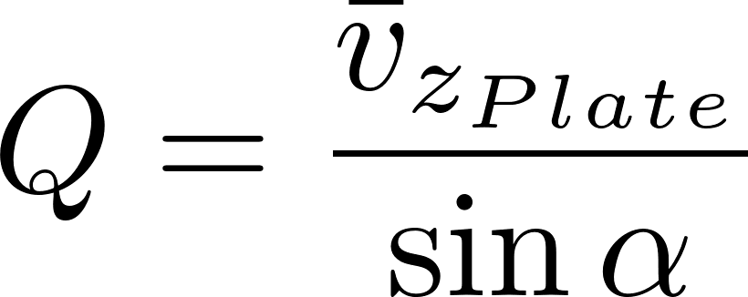
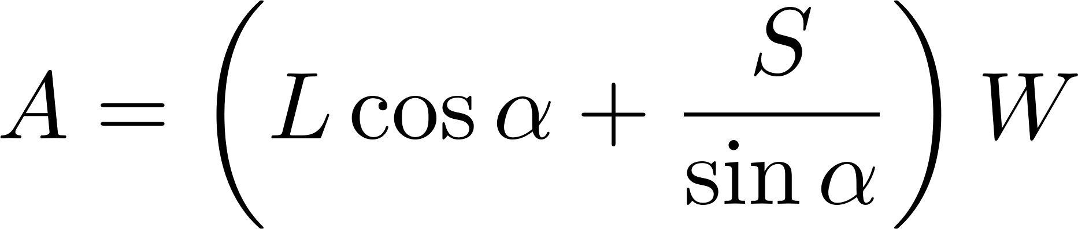
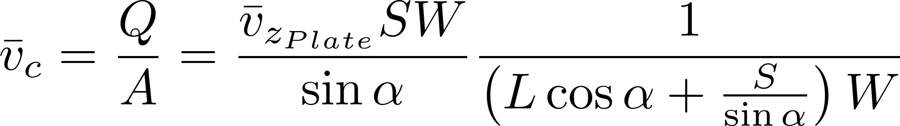
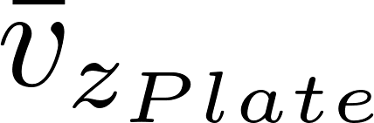
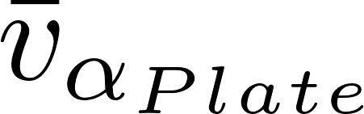
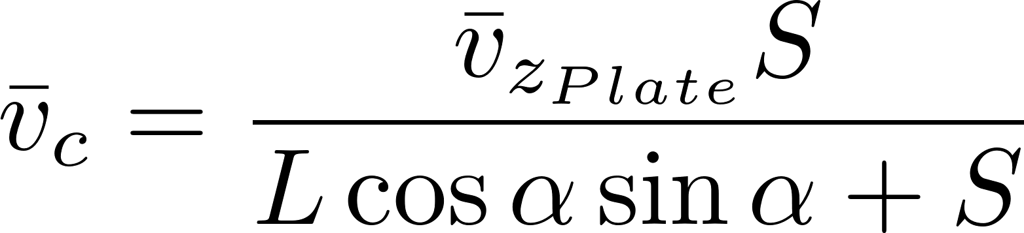
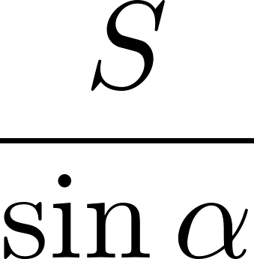
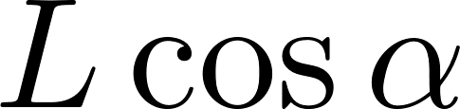
Comparison with Q/A_{s}
A_{s} is horizontal area over which particles can settle
H_{c}
L
H
S
α
α
Same answer!

Slide 10
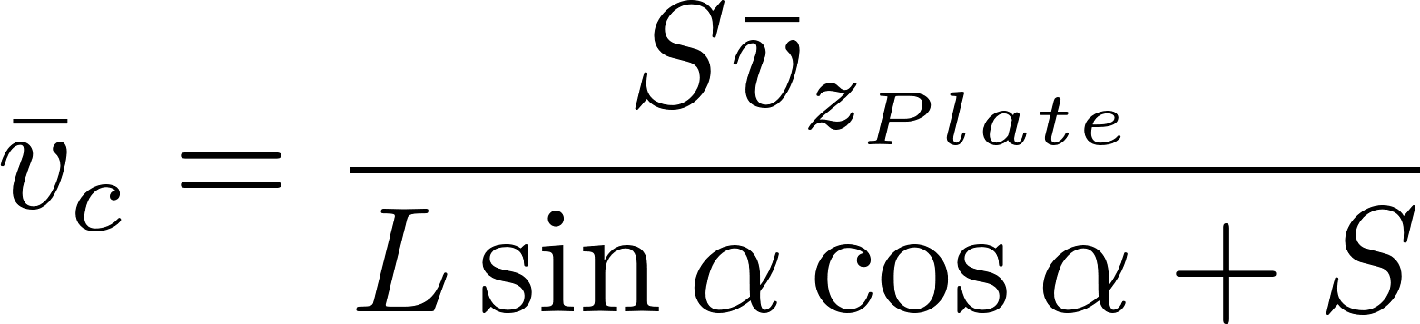
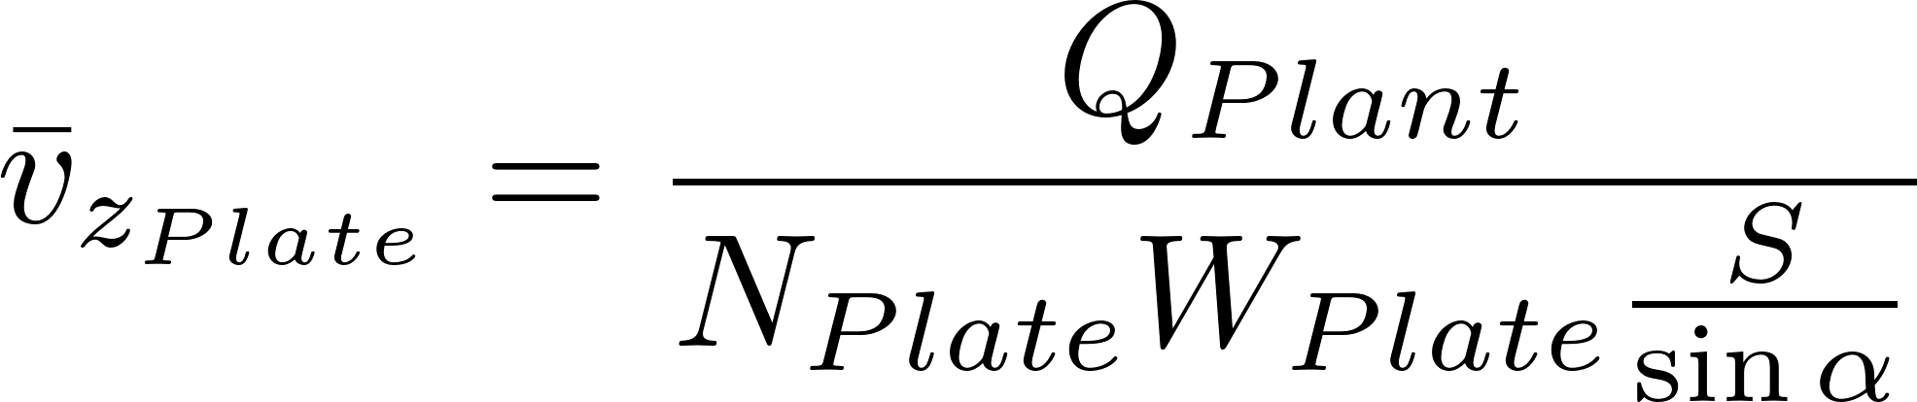
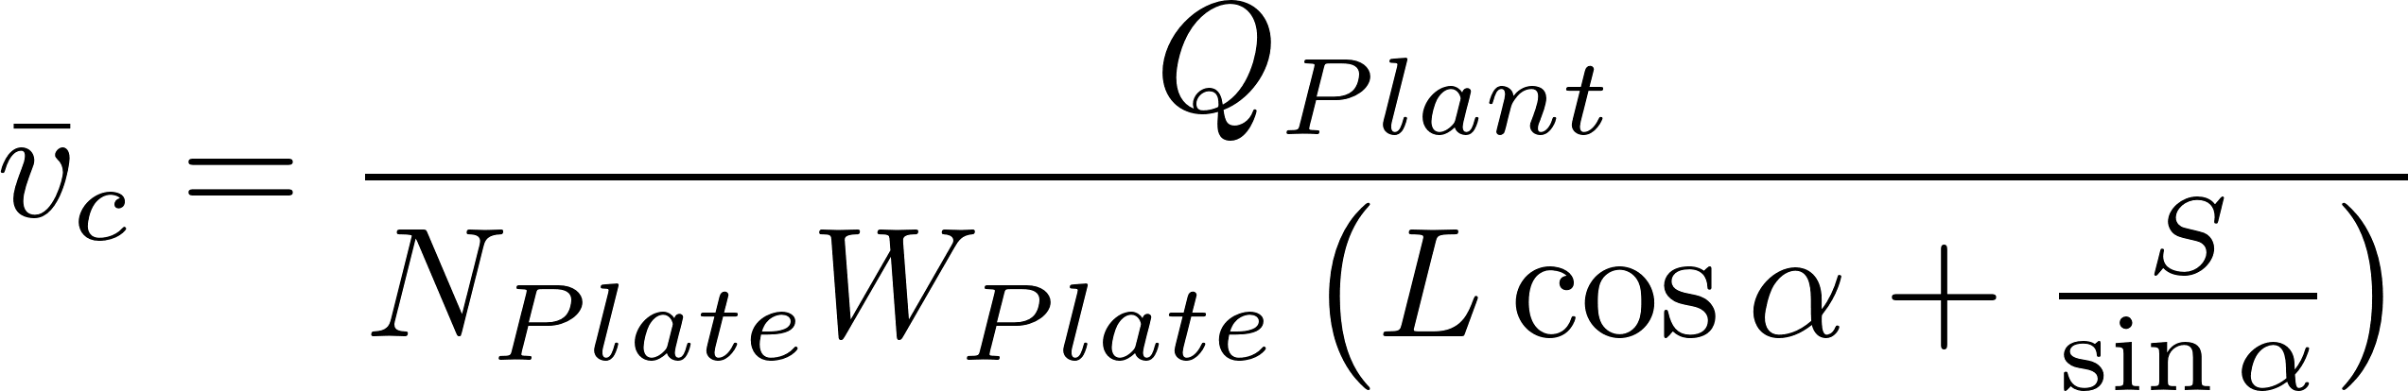
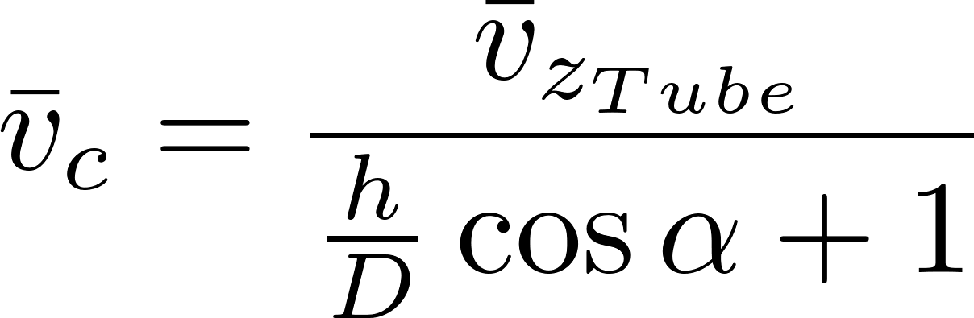
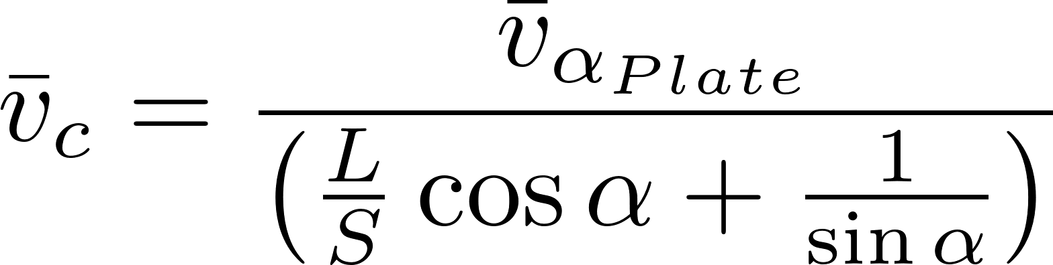
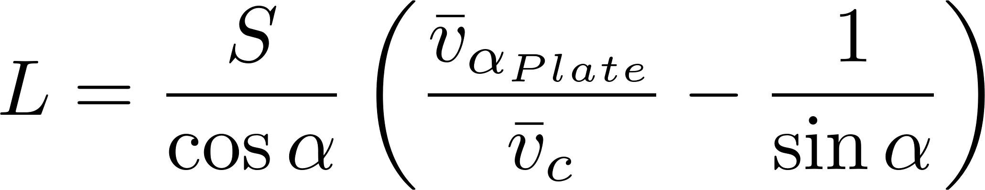
Equation for capture velocity
Tube settler

Slide 11
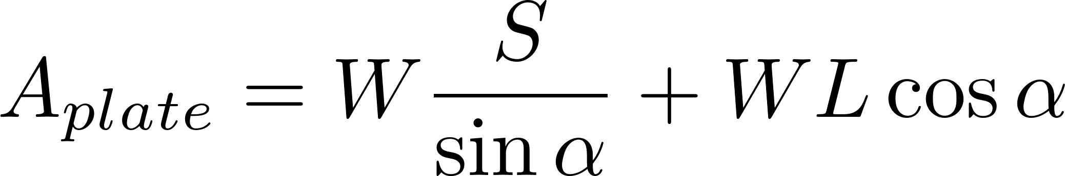
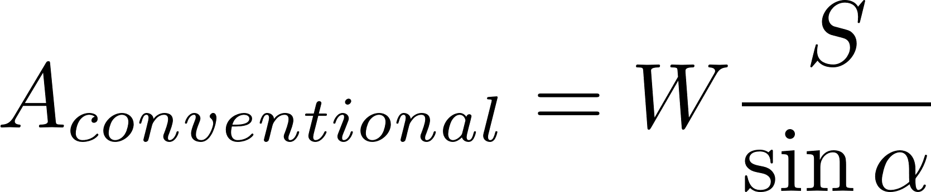
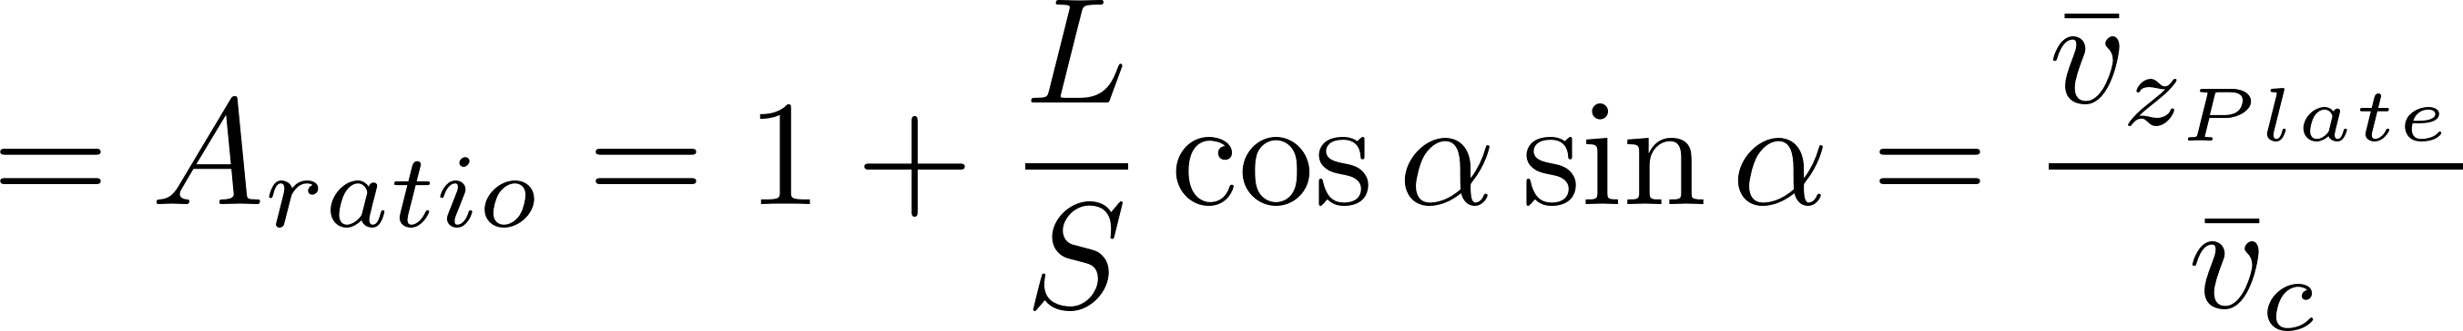
Performance ratio (conventional to plate/tube settlers)
Compare the area on which a particle can be removed
Use a single plate settler to simplify the comparison
L
S
Plate/tube capture area
Conventional capture area
α

Slide 12
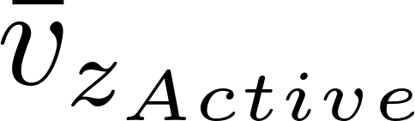
Thick Plate Settlers
S Distance between plate settlers
B Center to center distance
T Plate settler thickness
Vertical velocity component beneath the plate settlers
Vertical velocity component between the plate settlers
h_{c}
L
h
S
α
α

Slide 13
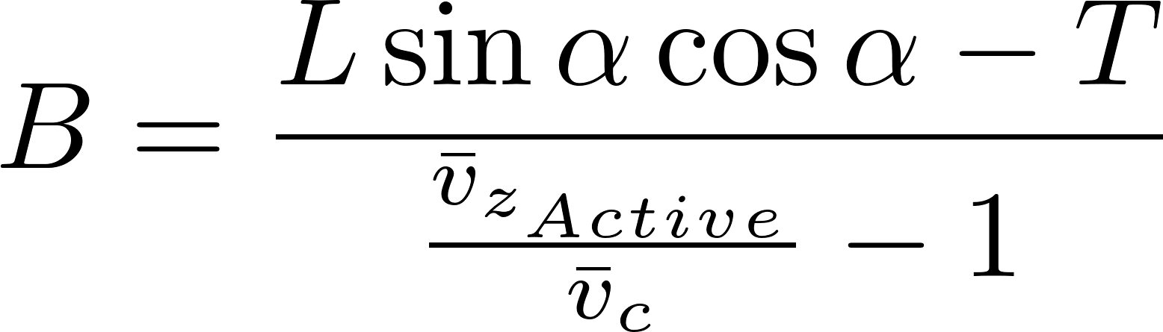
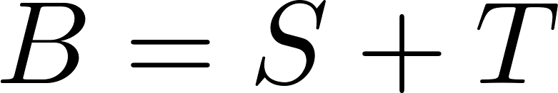
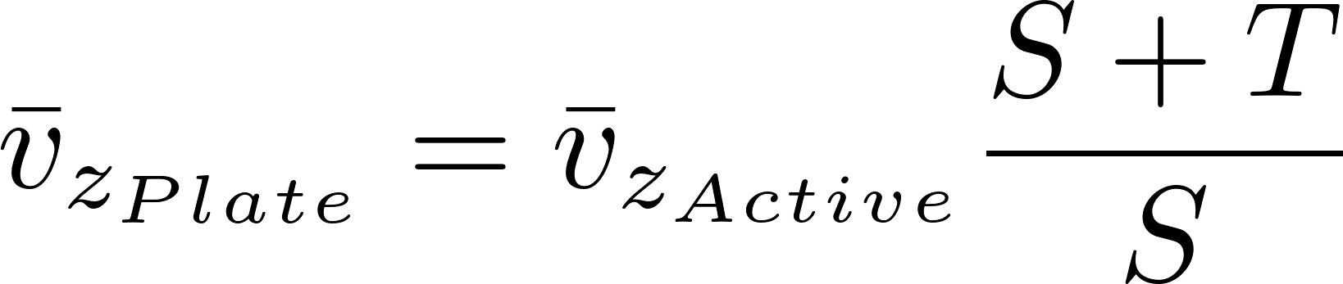
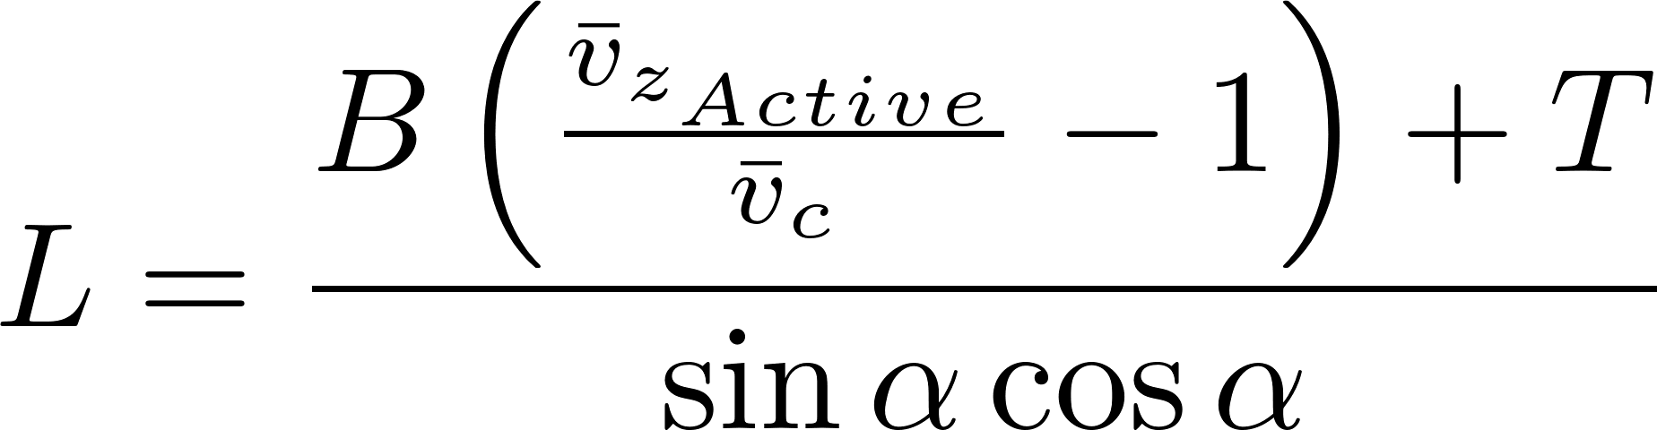
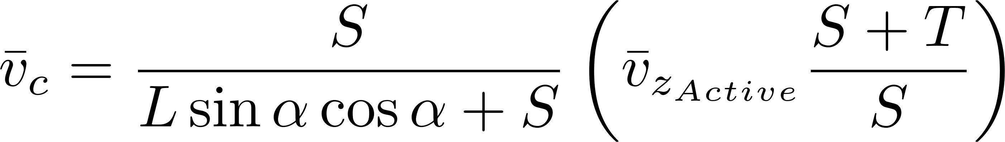
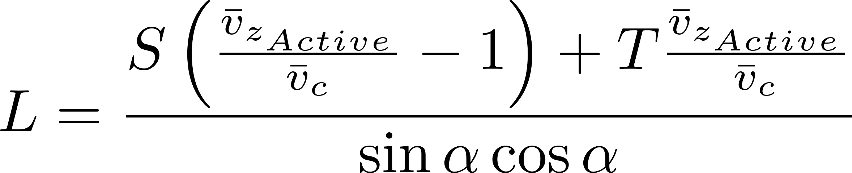
Thick Plate Settlers
Mass Conservation
Geometry

Slide 14
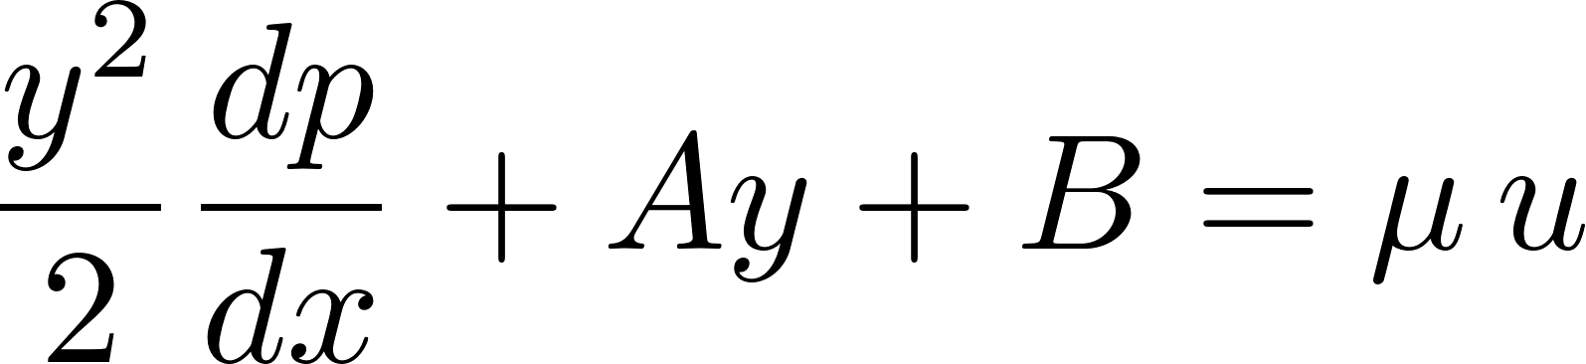
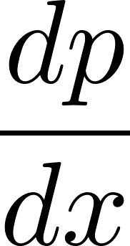

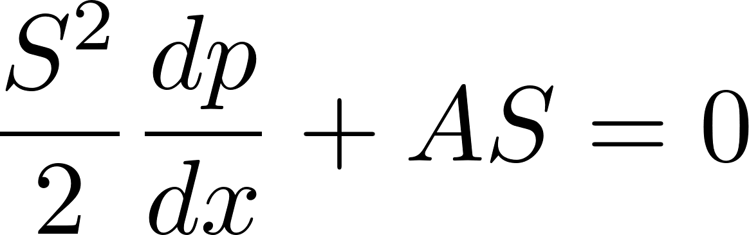
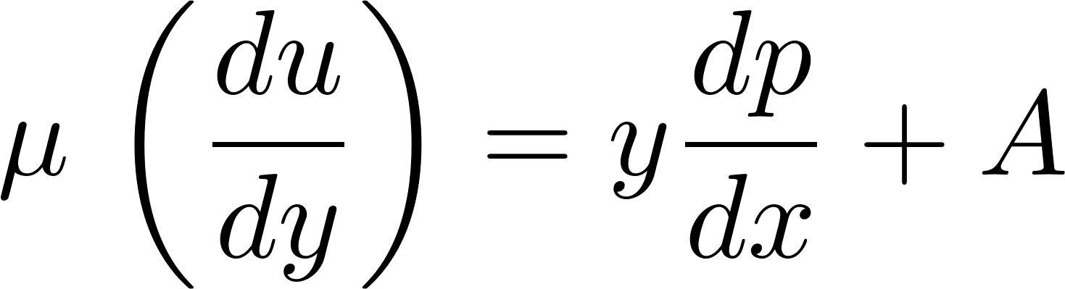
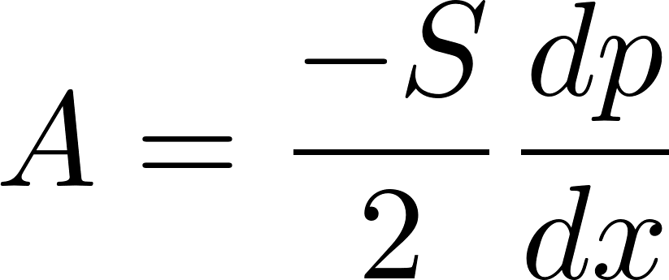
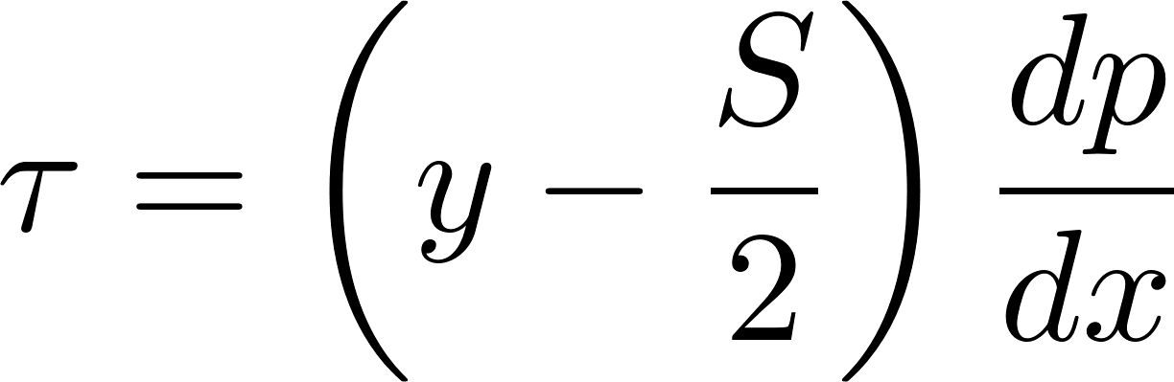
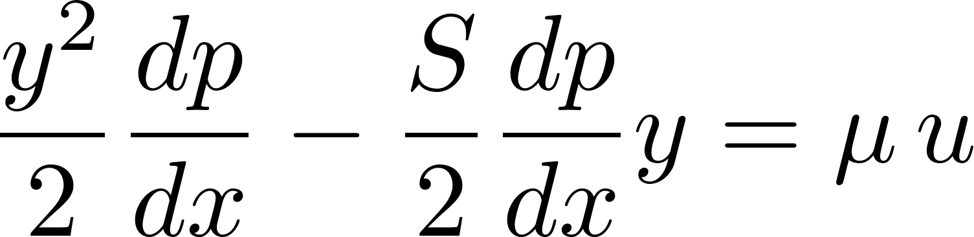
Infinite Horizontal Plates: Boundary Conditions
extra
y
No slip condition
u = 0 at y = 0 and y = S
S
τ
u
x
let
negative
be___________
What can we learn about τ?

Slide 15
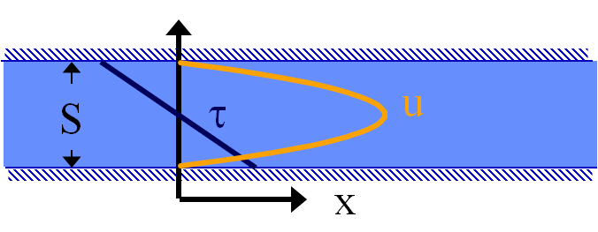
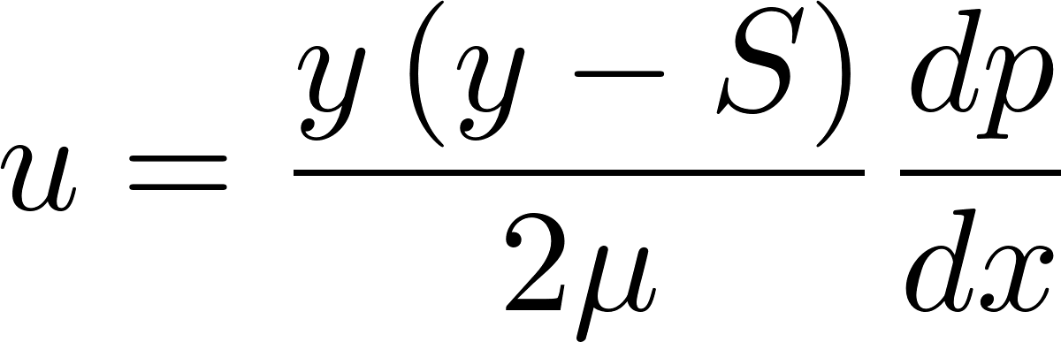
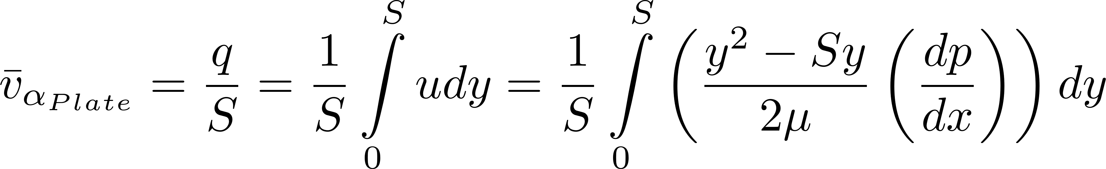
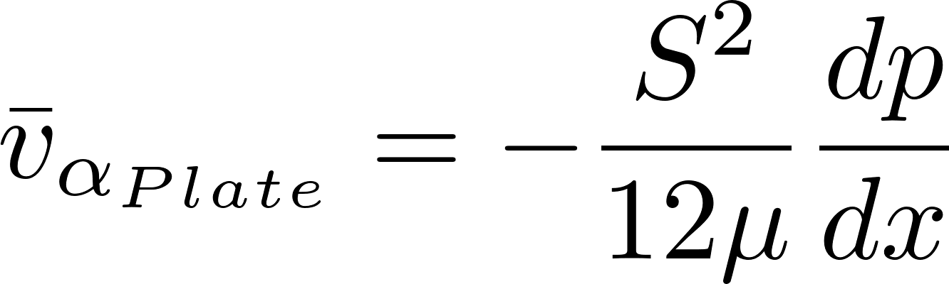
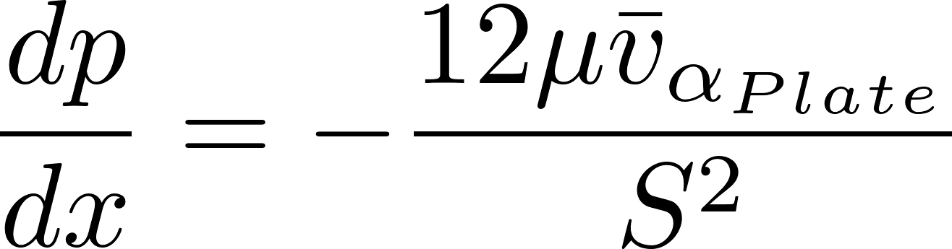
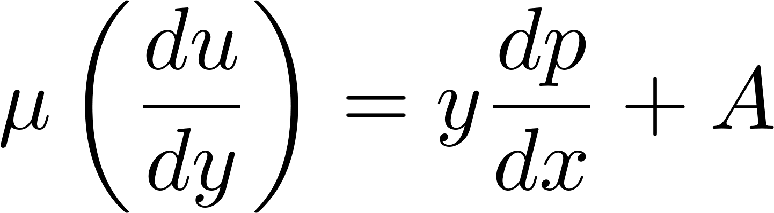
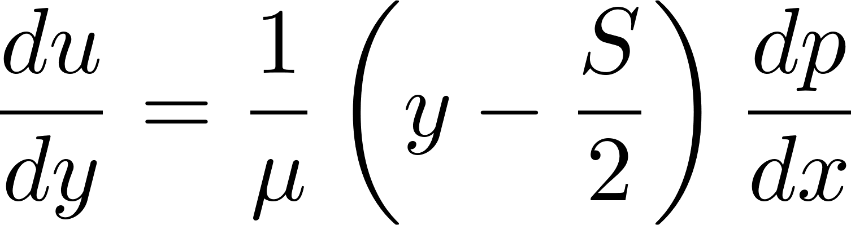
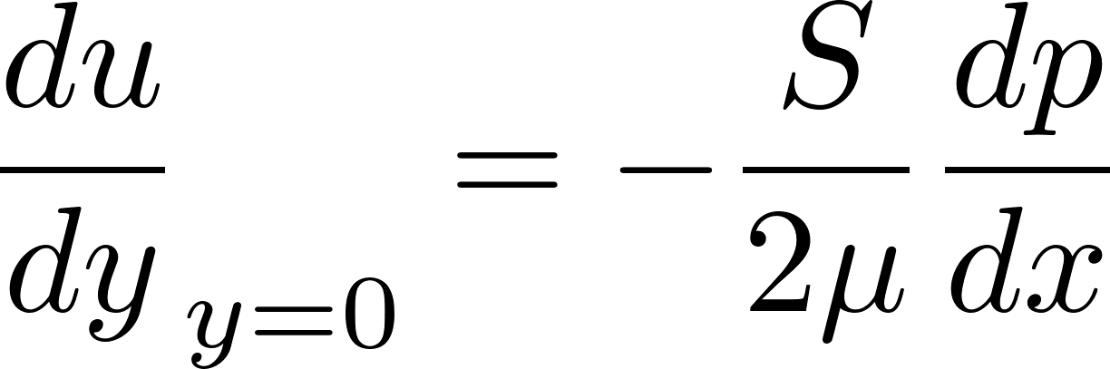
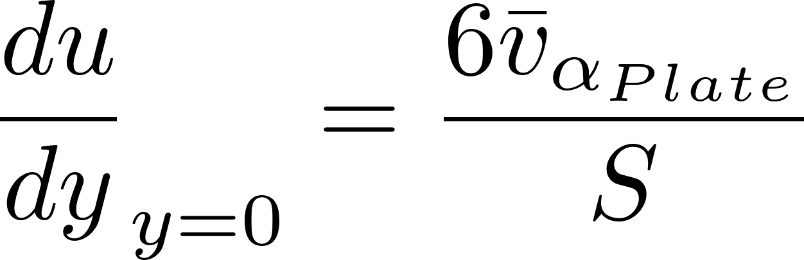
Navier Stokes Flow between Plates
extra
Integrate to get average velocity
is average velocity between plates
We have velocity gradient as a function of average velocity
Notes:
q is flow per unit width
u is fluid velocity as a function of location
S is spacing between the plates

Slide 16
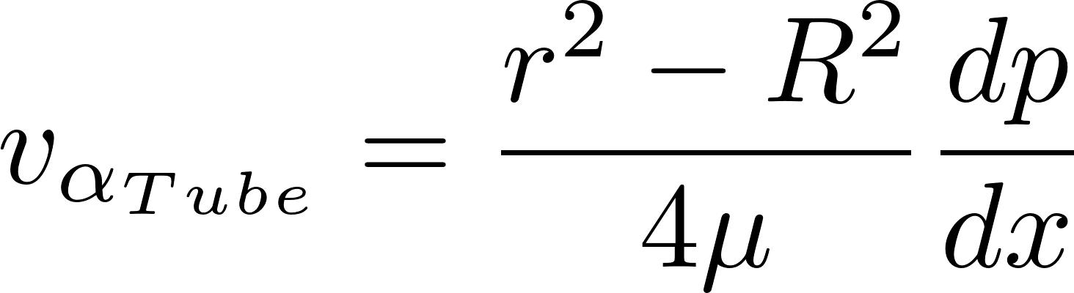
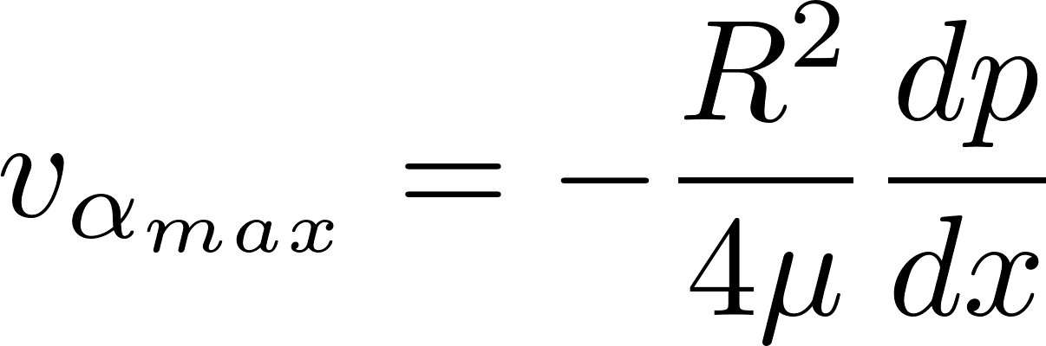
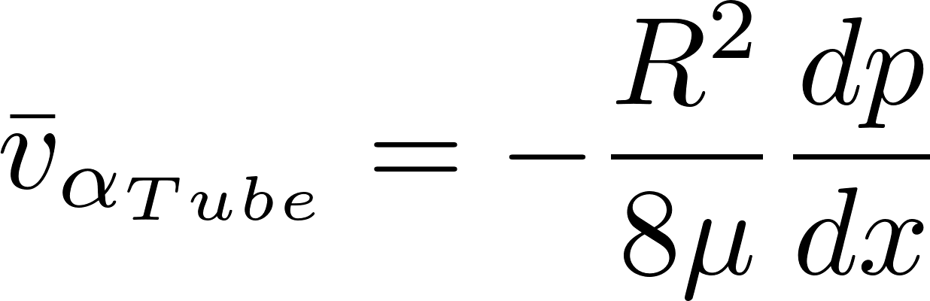
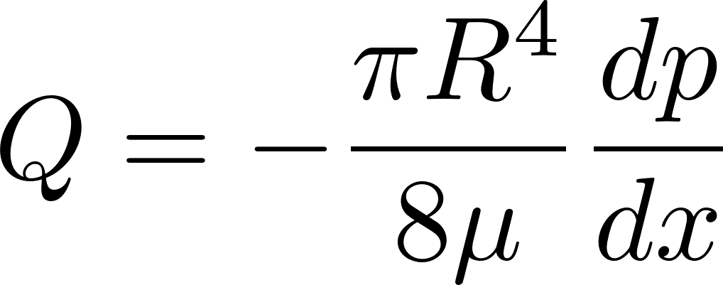
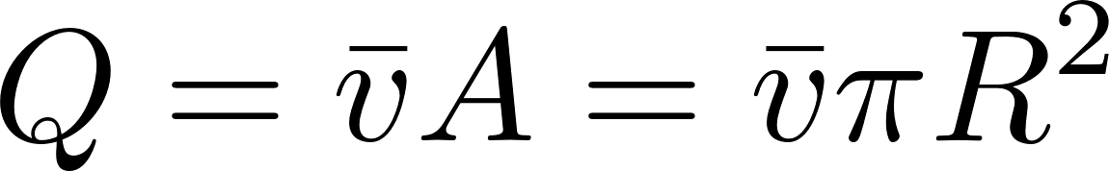
Laminar Flow through Circular Tubes: Equations no gravity
extra
R is radius of the tube
Max velocity when r = 0
Velocity distribution is paraboloid of revolution therefore _____________ _____________
average velocity (V) is 1/2 v_{max}

Slide 17





Velocity gradient at the wall
extra
Where dp/dx is the pressure gradient in the direction of flow NOT due to changes in elevation
Tube geometry
Plate geometry
Average velocity

Slide 18









Floc Rollup Constraint
extra
Velocity at center of floc
floc diameter
α
Linearized (plates)
gsin(α)
g
α
Failure point (floc stationary)
Terminal velocity
α
Notes:
d is floc diameter
What happens when floc slides down to high shear zone?

Slide 19


Spacing as a function of floc terminal velocity
extra
But terminal velocity and floc diameter are related!
Sedimentation velocity solved for diameter
This is the smallest spacing that will allow a floc with a given settling velocity to remain stationary on the slope (and not be carried upward)

Slide 20


Given fractal dimension = 2

Slide 21


Slide Capture Velocity
extra
$v_{Slide}$ is the terminal sedimentation velocity (V_{t}) of the slowest-settling floc that can slide down an incline. Flocs with this terminal velocity (the slide velocity) will be held stationary on the incline because of a balance between gravitational forces and fluid drag. Flocs with a terminal velocity lower than $V_{Slide}$ will be carried out the top of the tube (i.e., “roll up”) even if they settle onto the tube wall. Thus, the slide terminal velocity represents a constraint on the ability of plate settlers to capture flocs.
$V_{Slide}$ ↑
What happens if the primary particles are less dense? _____

Slide 22

Experimental Evidence that the Slide Capture Velocity Matters
extra
If V_{Slide} is bigger than V_{Settle}, then some flocs that we expected to capture will slide out the top
All experiments were performed at the same settle capture velocity
Floc Roll-up and its Implications for the Spacing of Inclined Settlers Matthew W. Hurst, Michael J. Adelman, Monroe L. Weber-Shirk, Tanya S. Cabrito, Cosme Somogyi, and Leonard W. Lion. Journal of Environmental Engineering, submitted (2012)
Notes:
Floc Roll-up and its Implications for the Spacing of Inclined Settlers Matthew W. Hurst, Michael J. Adelman, Monroe L. Weber-Shirk, \\Tanya S. Cabrito, Cosme Somogyi, and Leonard W. Lion. Journal of Environmental Engineering, submitted (2012)

Slide 23






Pressure drop (from head loss) through plate settlers
Velocity
Shear (wall on fluid)
Force balance
Viscous shear
Change L to maintain capture velocity
Notes:
The shear is acting on both plates. The pressure drop is due to the shear on the plates. The areas over which the shear and pressure act are different. As the space between the plates decreases the area over which the pressure is acting decreases too. Thus the pressure increases for two reasons. Area decreases and shear increases.

Slide 24

Plate Settler Head Loss
This represents an opportunity to improve design!
Head loss is tiny! We need some head loss to get reasonable flow distribution between (and within) plates. This lack of head loss may be one of the reasons for poor performance of full scale plate settlers. The velocity of any turbulent eddies or mean flow needs to be less than ______ to achieve uniform flow through plate settlers. The floc filter will end up helping us here!
4 mm/s
Notes:
This sets the maximum velocity in the space above the plates settlers.
The lack of significant head loss through plate settlers means that any turbulence or mean velocities in the bottom of the sed tank will propagate through the plate settlers and result in non uniform distribution of flow between plates. In order to obtain reasonable uniform flow we need the velocities below the plate settlers to be close to 1 mm/s even if we use closely spaced plates. This is a daunting challenge given that the upflow velocity is 1 mm/s and given that the velocity coming from the inlet manifold ports is on the order of 100 mm/s (and thus turbulent eddies with velocities that are order 10 mm/s). The distance between the manifold ports and the bottom of the plate settlers will result in significant energy dissipation. The fact that AguaClara sed tanks are shallower than conventional design means that we need to understand and perhaps take additional steps to minimize velocities at the inlets of the plate settlers.
The AguaClara team is working to reduce velocities in the bottom of the sed tank by improving the design of the inlet manifold. The team is also evaluating the performance of small diameter tube settlers to confirm that there aren’t any other unforeseen problems caused by reducing the separation between the plate settlers.

Slide 25

Lab scale floc filter, tube settler, floc hopper

Slide 26
Identify the failure modes for this geometry
1 m
Sed tank cross- section showing bottom geometry
Slot that runs the length of the sed tank
Inlet manifold/drain
Notes:
Flocs go down hill the whole way to the sed tank. Then they are resuspended until they land in the floc hopper and then it is down hill again to the plant drain.
There is only one place in the sed tank where flocs are resuspended.

Slide 27





Floc Terminal Velocity does increase with diameter
Terminal velocity
velocity here
Core particle diameter
Floc diameter
How fast a particle must fall to be captured by the plate settlers
Core particle density
Water density
Water kinematic viscosity
Fractal dimension
Notes:
All fractal dimensions greater than one are expected to increase the terminal velocity as the floc diameter increases.
Both floc blanket upflow velocity and plate settler capture velocity are AguaClara current design values, but are not optimized.

Slide 28

How can you drain and then refill an AguaClarifier?
Notes:
Why does the plug have a vertical tube? Serves as a handle and an air vent.

